Slide 1
Max Tegmark
and the Mathematical Multiverse
A presentation by Otto Mättas
Notes:
Today we'll explore one of the most fascinating and controversial ideas in modern physics
- Max Tegmark's Mathematical Universe Hypothesis and his hierarchy of multiverses.
We are not talking about parallel universes
- it's about the fundamental nature of reality itself.

Slide 2
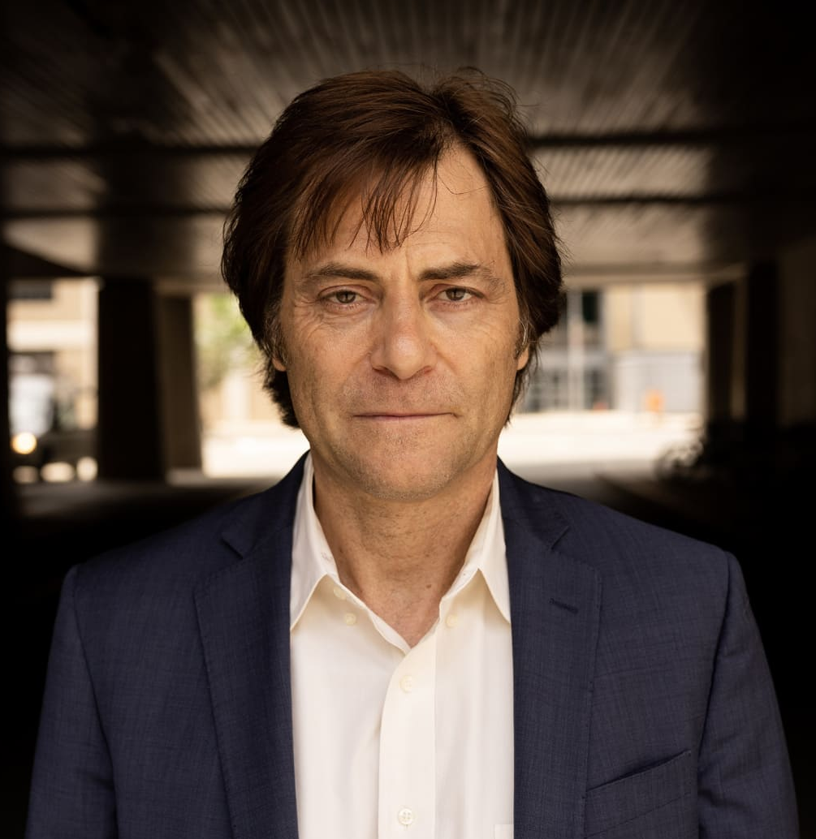
Max Erik Tegmark
b. 1967
Professor at MIT
President at the Future of Life Institute
Known for contributions to cosmology, quantum mechanics, and artificial intelligence
Notes:
Max Tegmark is one of the innovative thinkers in modern physics.
Born in 1967 in Sweden, he's now a physics professor at MIT where he bridges the gap between theoretical physics and artificial intelligence.
What makes him particularly interesting is his ability to combine rigorous mathematics with big philosophical questions.

Slide 3
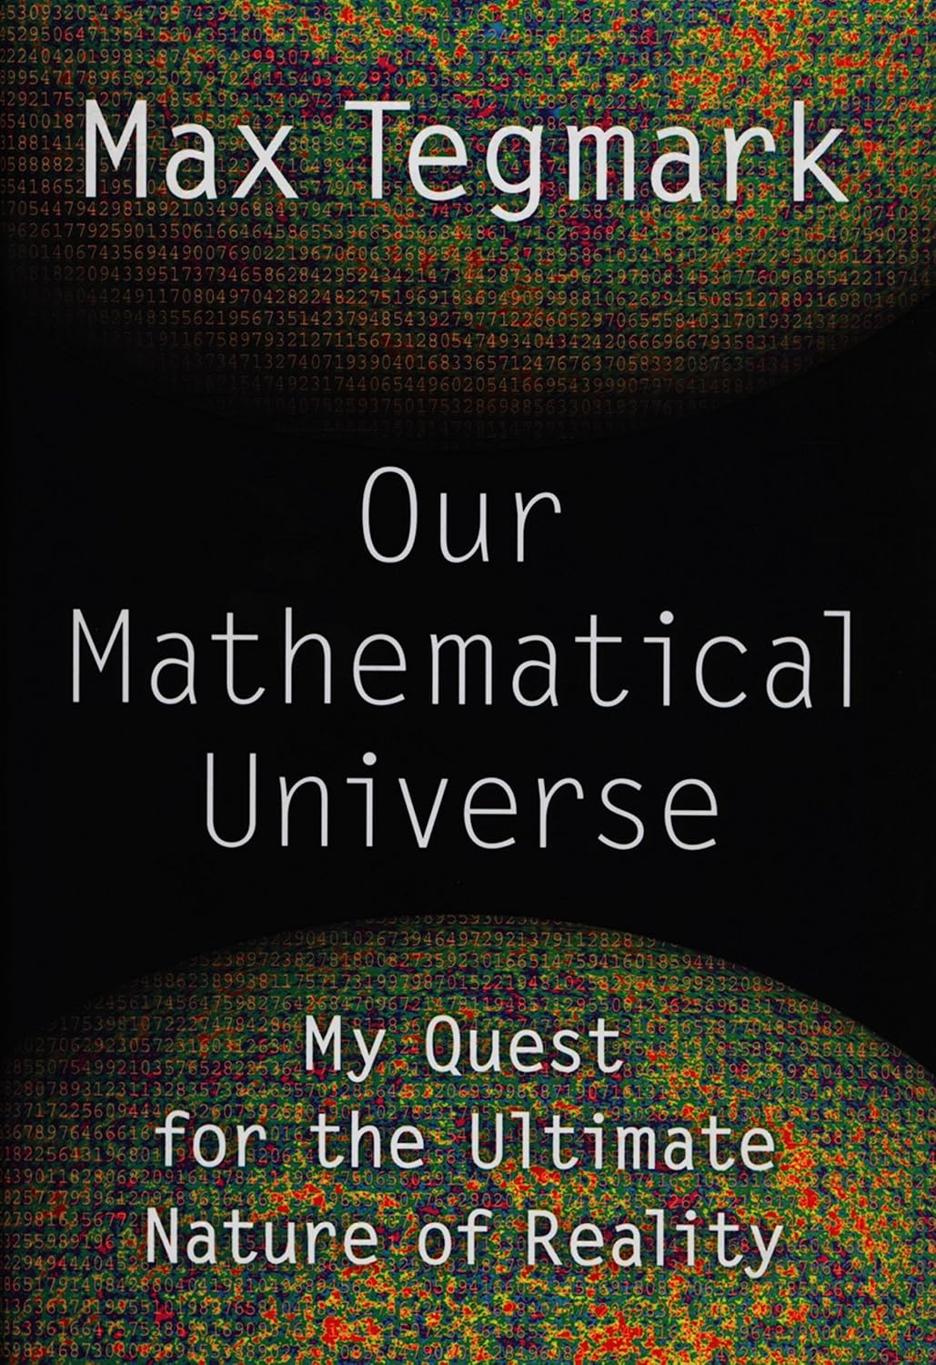
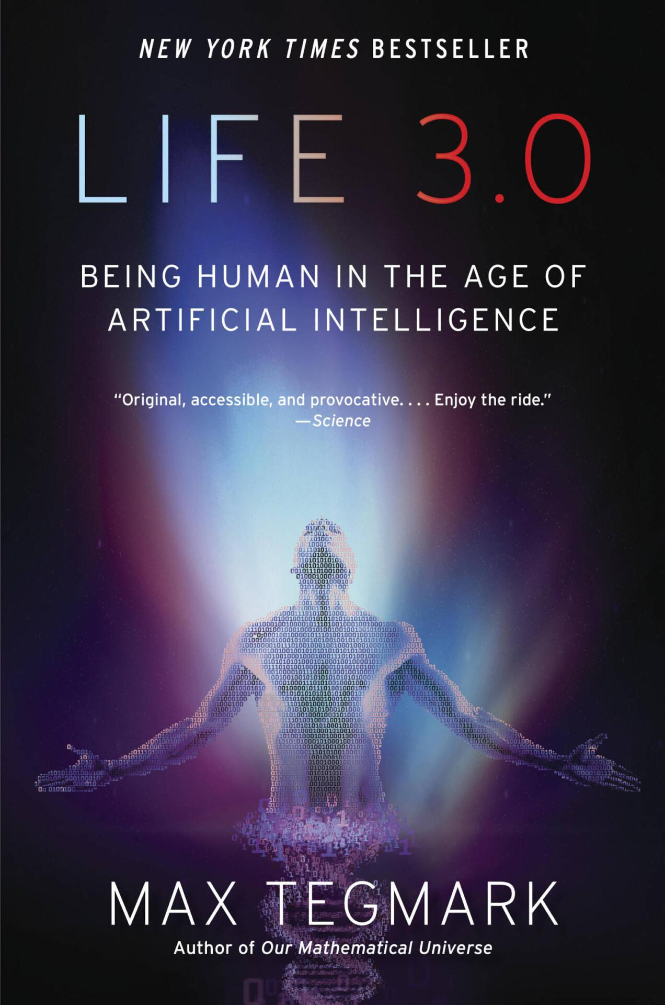
Notes:
He's perhaps best known for two groundbreaking books [POINT TO BOOK COVERS]
that challenge our understanding of reality and consciousness.
These two books represent Tegmark's intellectual journey.
"Our Mathematical Universe" presents his revolutionary idea that reality itself is a mathematical structure.
Notice how he chose "Our" rather than "The" - a deliberate choice acknowledging the possibility of other mathematical universes.
His second book, "Life 3.0," extends these ideas into the realm of artificial intelligence and consciousness.

Slide 4
The Multiverse Hierarchy
Notes:
Tegmark's major contribution to physics is his organisation of different multiverse theories into a coherent hierarchy.
Each level represents a different type of multiverse, with increasing levels of abstraction and controversy.
Let's explore each one.

Slide 5


Level I: Spatial Extension
Definition: Infinite space with repeated initial conditions
Key concept: Everything that can happen, does happen
Example: Another you making different choices ~10^10^100 meters away
If space is infinite, does this automatically follow?
Notes:
The Level I multiverse is perhaps the most straightforward to understand.
Imagine our universe extending infinitely in all directions.
If space is infinite, then everything that can happen according to physical laws must happen - somewhere.
[POINT TO LEGO HOUSES]
Just as these LEGO sets show different arrangements of the same pieces, Level I contains infinite variations of the same physical laws and constants.
Level I: Identical LEGO sets built differently

Slide 6
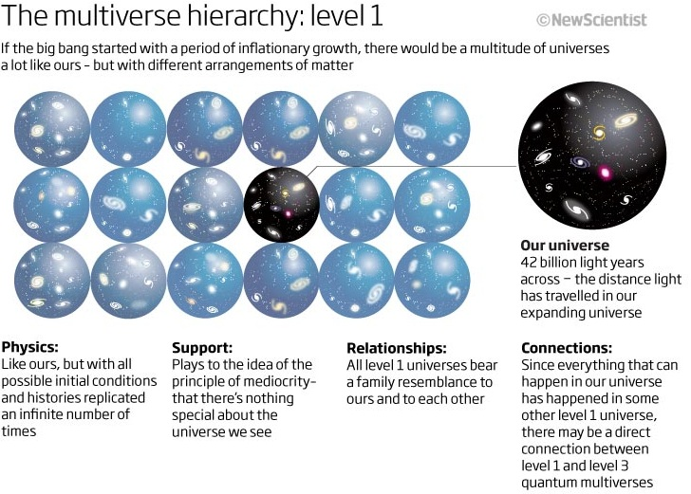
Notes:
[Continue with the diagrams]
According to this theory, there's another version of you about googleplex or 10^10^100 (or 1 followed by hundred zeros) meters away making slightly different choices.
This isn't science fiction - it's a mathematical consequence of infinite space with a finite number of possible particle arrangements.

Slide 7

Level II: Different Physical Constants
Definition: Other post-inflation bubbles with different physical laws
Analogy: Water states (solid/liquid/gas) vs universal constants
Example: Universes where electron/proton mass ratio differs
Are most physical constants just "cosmic addresses"?
Notes:
Level II takes us deeper.
Here, the multiverse contains regions with different fundamental constants.
[GESTURE TO SNOW-COVERED HOUSE]
Just as water can exist as solid, liquid, or gas, Tegmark suggests that space itself might have different "phases" with different physical laws.
The electron/proton mass ratio of 1836 that we observe might just be our local "cosmic address."
Level II: Different LEGO sets with different pieces

Slide 8
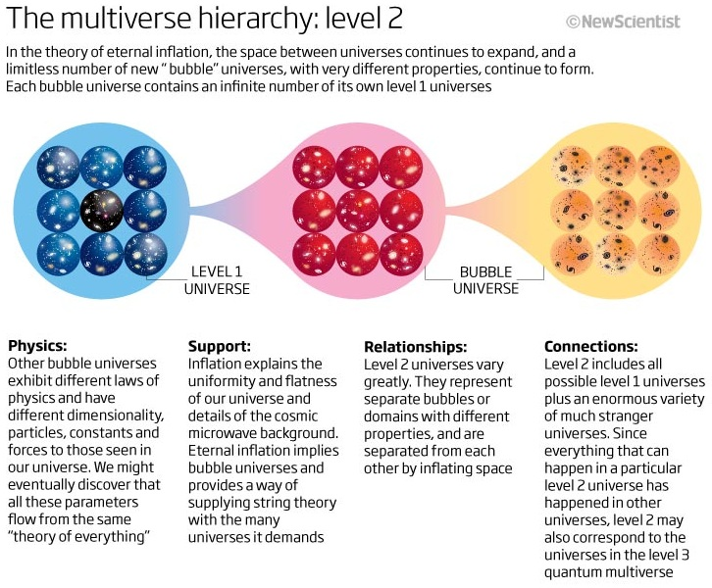

Slide 9
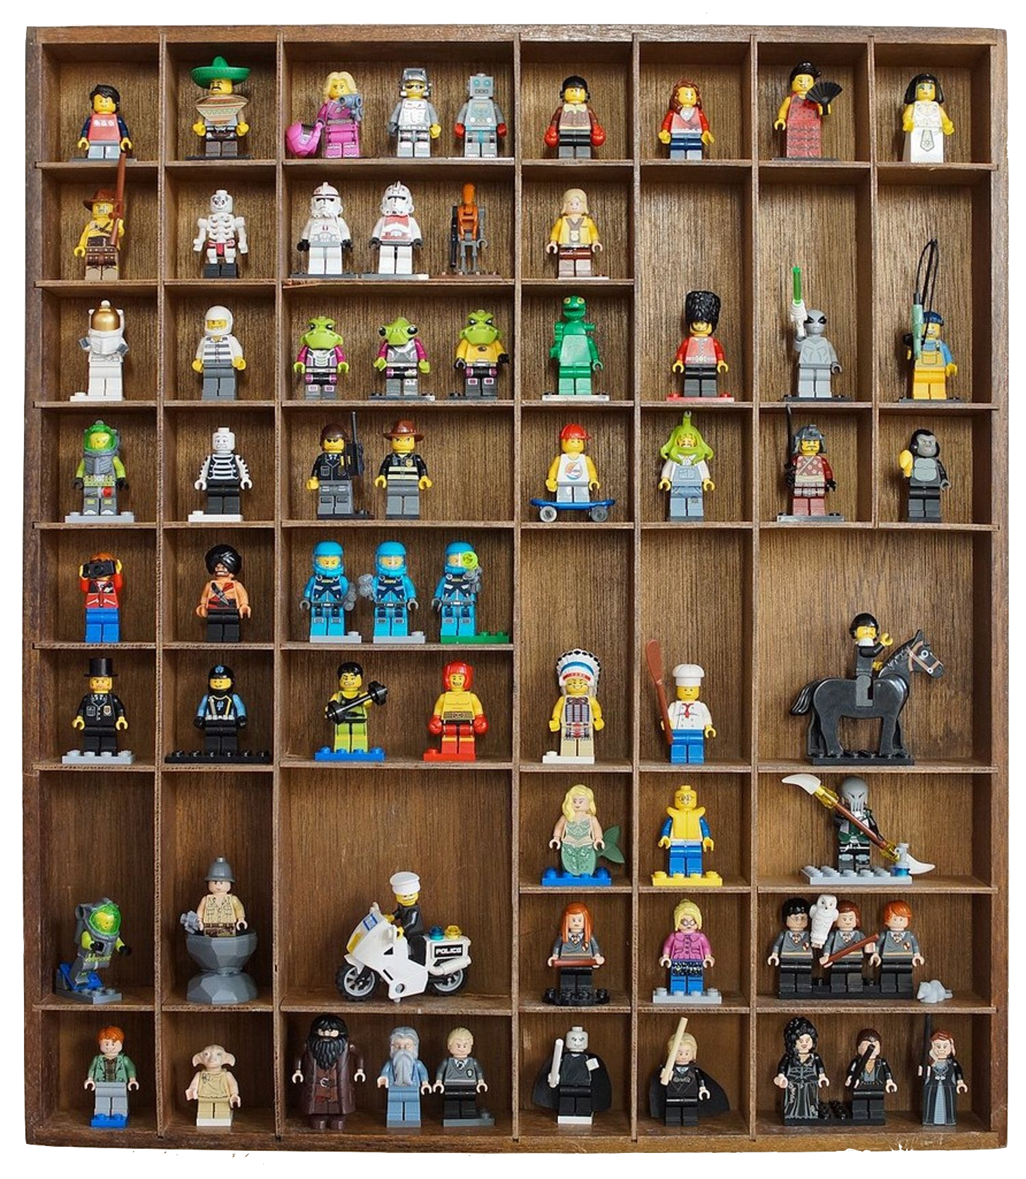
Level III: Quantum Many Worlds
Definition: Everett's interpretation of quantum mechanics
Key concept: All quantum possibilities realised
Thought experiment: The hospital cloning scenario
How does this differ from Level I?
Notes:
This is where things get really interesting.
Level III comes from Everett's interpretation of quantum mechanics.
[POINT TO MINIFIGURE COLLECTION]
Just as each of these figures represents a different character, quantum mechanics suggests that every possible quantum outcome exists in some branch of reality.
The key difference from Level I is that these branches exist in a quantum superposition rather than being spatially separated.
Level III: Every possible LEGO configuration existing simultaneously
The Hospital Cloning Scenario:
Imagine you're sedated in a hospital and told that you'll be cloned
One copy will wake up in Room 1, one in Room 2
Both copies will be identical down to the atomic level
When you wake up, it will feel random which room you're in
This illustrates how quantum branching feels subjectively "random" even though the overall process is deterministic

Slide 10
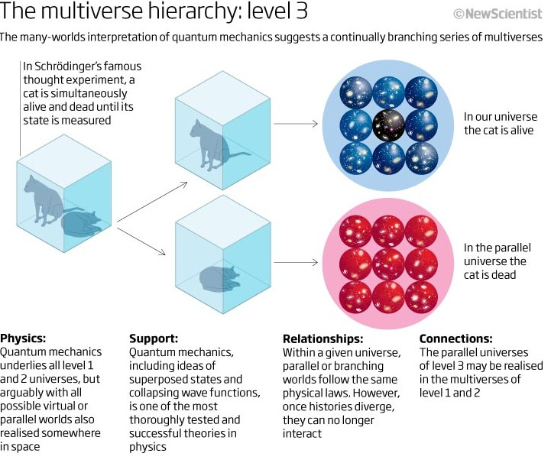

Slide 11
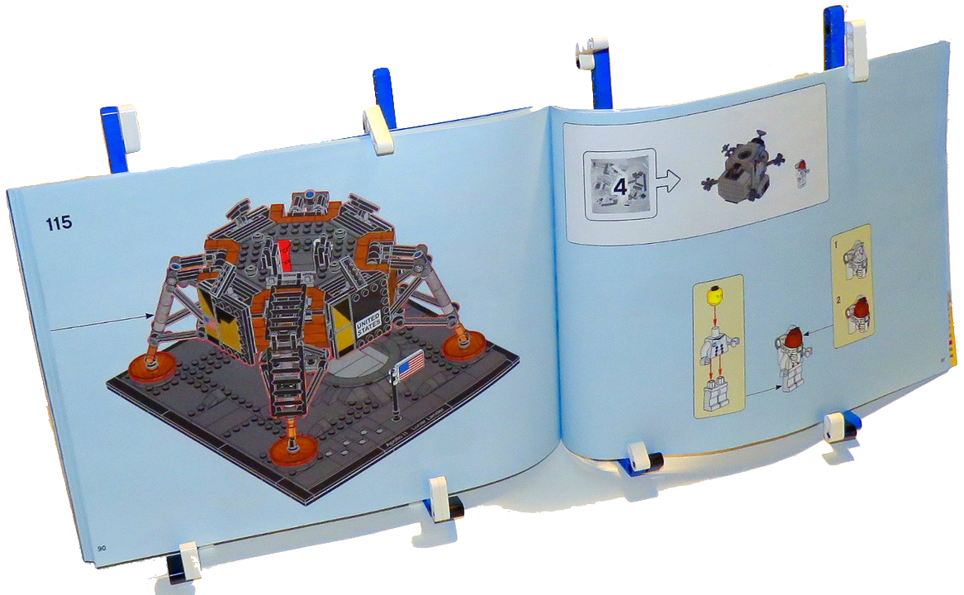
Level IV: Mathematical Structures
Definition: All mathematical structures exist
Key concept: Physical existence equals mathematical existence
Example: Platonic solids as discovered, not invented
What makes this different from Jorge's Library?
Notes:
This is Tegmark's most controversial and profound idea.
He suggests that all mathematically consistent structures actually exist.
[REFERENCE PLATONIC SOLIDS]
Just as we discovered rather than invented the Platonic solids, Tegmark argues that all mathematical structures have their own form of existence.
This differs from Jorge's Library because it's about consistent mathematical structures, not random combinations.
Platonic Solids:
These are the five regular 3D shapes where all faces are identical regular polygons: tetrahedron, cube, octahedron, dodecahedron, icosahedron
Plato believed these represented fundamental patterns in nature
Key point in Tegmark's argument: You can't "invent" a 6th regular platonic solid - the mathematics only allows these five
Tegmark uses this to illustrate how mathematical structures are discovered rather than invented
Just as mathematicians discovered (not invented) these solids, Tegmark argues all mathematical structures already "exist" in a similar way
Level IV: The LEGO instruction manual itself being real

Slide 12
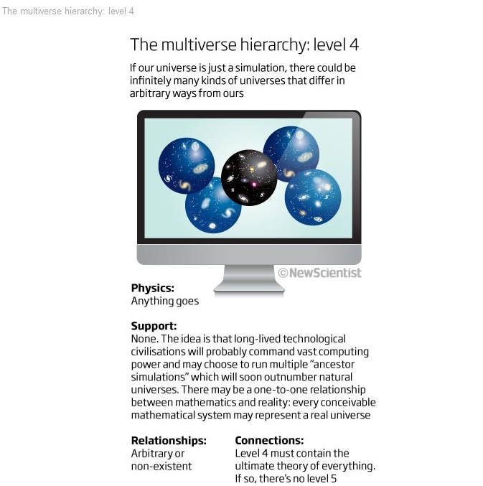
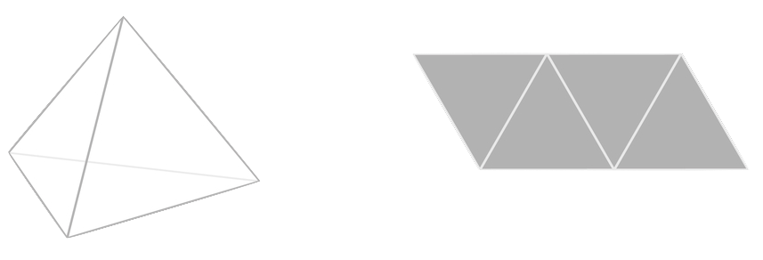
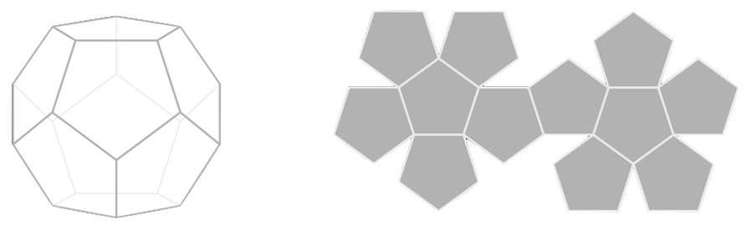
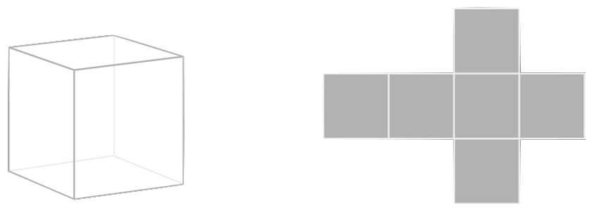
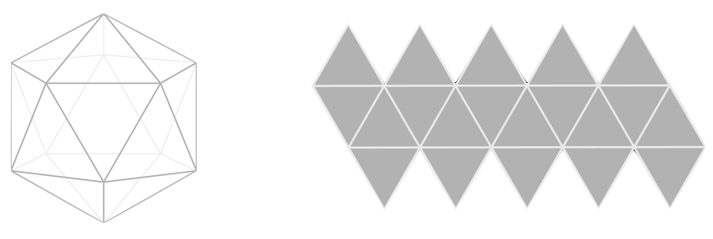
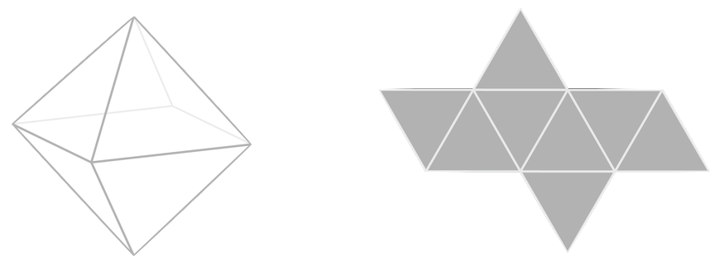
Tetrahedron
Dodecahedron
Cube
Icosahedron
Octahedron
Notes:
Platonic solids show how mathematical structures can exist independently of physical reality

Slide 13
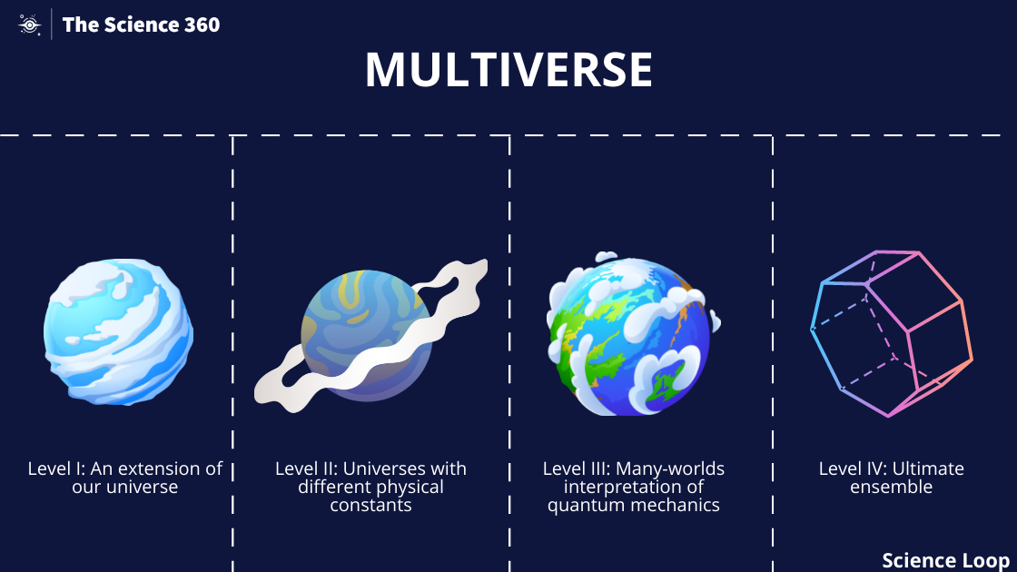

Slide 14
The Mathematical Universe Hypothesis
Notes:
This is the heart of Tegmark's proposal.
He argues that our reality isn't just described by mathematics - it IS mathematics.
No "special sauce" needed. What do I mean by this?

Slide 15
Deep Dive
Core Arguments
Everything describable is mathematical
No non-mathematical properties discovered
Simplicity argument: No "special sauce" needed
Counter-arguments and Responses
The consciousness problem
The complexity problem
The selection problem
Notes:
This leads to three core arguments [LIST THEM],
but also faces some serious challenges [REFERENCE COUNTER-ARGUMENTS].
The Consciousness Problem:
How does subjective experience emerge from mathematics?
What gives rise to the feeling of experiencing math "from inside"?
How do mathematical structures become self-aware?
Can consciousness be fully described mathematically?
The Complexity Problem:
How do we measure the complexity of mathematical structures?
Why do we observe this particular level of complexity?
How do we avoid infinite complexity?
What determines which structures are "interesting" enough to contain conscious observers?
The Selection Problem:
Why do we observe these particular mathematical laws?
How do we explain the apparent fine-tuning of physical constants?
What determines which mathematical structure we experience?
Is there a principle that selects for consciousness-supporting structures?

Slide 16
Practical Implications
Notes:
This isn't “just” philosophy - it has real implications for both physics and philosophy.

Slide 17
Practical Implications
For Physics
Prediction: All properties must be mathematical
Research direction: Look for mathematical patterns
Impact on fundamental physics
For Philosophy
Nature of reality
Consciousness and experience
Free will and determinism
Notes:
[GO THROUGH BOTH COLUMNS]
For physics, it suggests that any property we discover must have a mathematical description.
Prediction that everything must have mathematical description
No room for truly random processes
Need to search for deeper mathematical patterns
Physical constants might be more like "addresses" than fundamental
Could guide unification attempts in physics
For philosophy, it raises profound questions about consciousness, free will, and the nature of reality itself.
Questions traditional concepts of existence
Challenges mind-body dualism
Affects how we think about causality
Impacts free will debates
Changes how we think about consciousness

Slide 18
Contemporary Relevance

Slide 19
Contemporary Relevance
Connection to Modern Physics
String theory implications
Quantum computation
AI research
Current Research
Tegmark's AI work at MIT
The Intelligible Intelligence Project
Future implications
Notes:
Tegmark's ideas continue to influence modern physics and AI research.
[HIGHLIGHT CURRENT RESEARCH]
His work at MIT on the Intelligible Intelligence Project shows how these abstract ideas connect to practical AI development.
Guides approaches to quantum gravity
Influences AI development (especially interpretable AI)
Suggests new ways to think about consciousness research
Impacts how we approach cosmology
Could affect how we design simulations

Slide 20
Discussion Points

Slide 21
Key Questions
Does our universe have non-mathematical properties?
If there are infinite copies of you making different decisions, does free will exist?
If everything mathematical exists, why do we experience this particular reality?
How does consciousness fit into a purely mathematical universe?
What would falsify the Mathematical Universe Hypothesis?
Does this theory make testable predictions?
Notes:
These are the questions that should drive our discussion.
[READ FIRST TWO QUESTIONS]
They challenge us to think about our place in this mathematical cosmos and what it means for human experience and free will.

Slide 22
Thought Experiments
The Simulation Argument connection
The "Mathematical Soul" comparison
The complexity paradox
Notes:
Let's end with three thought experiments that help us grasp these ideas.
[GO THROUGH EACH]
The Simulation Argument is particularly relevant today as we develop more powerful AI systems.
The Simulation Argument Connection:
If the Mathematical Universe Hypothesis is true, we could be a simulation
But unlike traditional simulation arguments, we'd be a mathematical structure being "computed"
There's no meaningful difference between being "simulated" and being "real"
Connects to Bostrom's argument but avoids infinite regress problem
Bostrom's simulation argument suggests we're likely living in a simulation
But this raises the question: who simulates the simulators?
This leads to infinite regress: simulations within simulations within simulations…
Tegmark's mathematical universe avoids this by saying it's "math all the way down"
There's no need for a "base reality" or "hardware" running the simulation because mathematical structures exist abstractly
The "base reality" could itself be mathematical
The Mathematical Soul Comparison:
People often argue against mathematical reality by saying "But what about souls/consciousness?"
Tegmark counters by asking what properties a "soul" would have that couldn't be mathematical
Any interaction with physical reality must follow mathematical patterns
Any non-mathematical properties would by definition be undetectable
Similar to arguments about whether AI can be conscious
The Complexity Paradox:
If all mathematical structures exist, why don't we observe chaos?
If all mathematical structures exist, most should be chaotic and complex
Think of random equations vs. the elegant equations we find in physics
The paradox: why do we observe relatively simple, ordered physical laws?
By pure probability, we should be in a much more chaotic universe
This connects to another problem: most mathematical structures would be incompatible with conscious observers
Yet we find ourselves in a universe with remarkably simple and elegant mathematical laws
Why does our universe follow relatively simple mathematical laws?
Tegmark suggests simpler structures might be more common
Could be similar to how we use Occam's Razor in science
Philosophical principle: "Entities should not be multiplied beyond necessity"
In science: simpler explanations are preferable to complex ones
Modern interpretation: among competing hypotheses, choose the one with fewest assumptions
In Tegmark's theory:
Perhaps simpler mathematical structures are more common
Could explain why we observe simple physical laws
Might serve as a selection principle among mathematical structures
Similar to how simple theories tend to be more successful in physics
Points to a possible selection principle among mathematical structures.
The complexity paradox suggests there must be some principle favoring simple structures
Occam's Razor might provide that principle, explaining why we observe simple mathematical laws

Slide 23
In Conclusion
Mathematical structures have an abstract existence
This existence doesn't require any physical substrate
Simple structures might be more fundamental
Our observed reality might be one of the simpler mathematical structures
This could explain why physics follows elegant mathematical patterns rather than chaos

Slide 24
Our external physical reality is a mathematical structure.
Mathematical existence is freedom from contradiction. Hilbert
If you're simulated, live an interesting life.
Notes:
I'll leave you with these three quotes that capture the essence of Tegmark's vision.
[READ QUOTES]
Remember: if we are in a simulation, Tegmark suggests we should make it an interesting one!

